Slide 1
The Future of Resource Sharing through Interlibrary Loan
Amie Freeman and Amber Cook
University of South Carolina

Slide 2
Where we want to go
Where we are
Where we’re going

Slide 3
Departmental Overview of USC’S ILL
2 librarians, 4 full-time staff, 1 part-time staff, 3 student workers
Use ILLiad for request management and process OCLC requests and provide technical service for 8 regional campuses
Other resource sharing (PASCAL) not handled through our office
Processed over 45,000 requests between the three services: Borrowing, Lending, and Document Delivery last fiscal year

Slide 4
Looking at you:
What’s happening in your ILL department these days?
Image Conrad von Soest [Public domain], via Wikimedia Commons

Slide 5
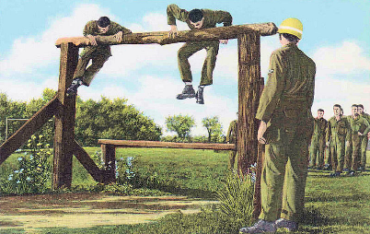
ILL obstacles
High costs of service (shipping, charges between libraries, costs of per-article journal content)
Reduced spending on print materials
Author and publisher embargoes
Barriers to e-content sharing
Restrictive licensing agreements
Image United States Air Force (United States Air Force) [Public domain], via Wikimedia Commons

Slide 6
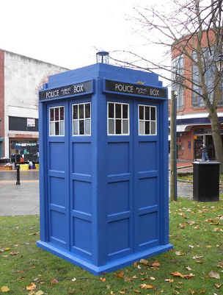
Envisioning the future
The big picture
Specific projects
Future projects your ideas
Image modified from Rept0n1x [CC BY-SA 3.0 (http://creativecommons.org/licenses/by-sa/3.0)], via Wikimedia Commons

Slide 7
In an ideal world…
Reference and collection development services
Copyright and fair use considerations
Increased consortia activity
Shared repositories
On demand digitization
Expanded open and freely-available resource workflows and policies
Expanded sharing of library licensed or purchased electronic materials

Slide 8
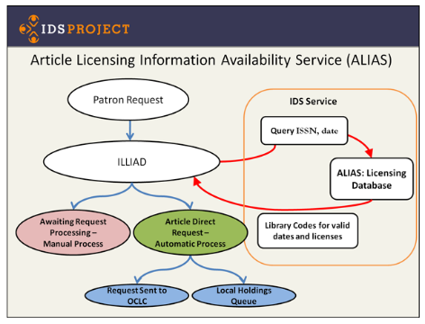
Projects shaping our future
GIST
ALIAS
Occam’s Reader
OBILLSK
ALIEN
Open Access Projects
Scholars Trust
Image by IDS Project, available from http://www.idsproject.org/tools/alias.aspx

Slide 9
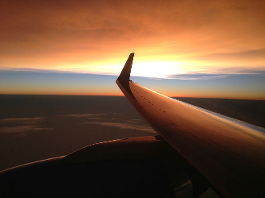
Reaching our destination
Review and expand your policies regularly
Stay aware of technological advances
Communicate and collaborate with your peers
Look for opportunities to promote and expand your services
Be an advocate for the resource sharing community within your library and beyond
Have a five year plan (but be willing to adjust)
Image by U.S. Department of State from United States [Public domain], via Wikimedia Commons

Slide 10
Take-home activity
Image by Wendi Gratz via https://www.flickr.com/photos/shinyhappyworld/5634941531, CC BY-NC-SA
Notes:
Final activity--your practical steps for the future
Does anyone want to share?

Slide 11
Imagine: where could we be in twenty years?
ILL to libraries on Mars?

Slide 12
Contact
Amie Freeman dillarda@mailbox.sc.edu
Amber Cook gibbsca@mailbox.sc.edu

